Slide 1
Text summarization
process of generating short, fluent, and most importantly accurate & essential summary of a longer text document.
How to do text summarization: Text cleaning, Sentence tokenization, Word tokenization, Word-frequency table, Summarization
Why automatic text summarization?
Summaries reduce reading time.
When researching documents, summaries make the selection process easier.
Automatic summarization improves the effectiveness of indexing.
Automatic summarization algorithms are less biased than human summarization.
Personalized summaries are useful in question-answering systems as they provide personalized information.

Slide 2
Type of summarization
Based on input type:
Single Document, where the input length is short.
Multi-Document, where the input length is long.
Based on the purpose:
Generic, where the model makes no assumptions about the domain or content of the text to be summarized and treats all inputs as homogeneous.
Domain-specific, where the model uses domain-specific knowledge to form a more accurate summary. For example, summarizing research papers of a specific domain, biomedical documents, etc.
Query-based, where the summary only contains information that answers natural language questions about the input text.
Based on output type:
Extractive, where important sentences are identified & selected from the input text to form a summary. Most summarization approaches today are extractive in nature. Eg; frequency-based methods will tend to rank the sentences in a text in order of importance by how frequently different words are used.
Abstractive, where the model forms its own phrases and sentences like what a human would generate. This approach is definitely more appealing, but much more difficult than extractive summarization Eg; Deep Learning (casting summarization as a seq2seq problem) & Transformer

Slide 3
Bilingual Evaluation Understudy-(BLEU)
Translating text from source to target language
Calculated by comparing the n=grams of machine translated sentences to n-grams of human translated sentences.
Consider the two reference translations R1 and R2 produced by human experts, and the candidate translation C1 produced by our translation system.
R1: The cat is on the mat, R2: There is a cat on the mat, C1: The cat and the dog.
Precision=No. of correctly predicted words/total no. of predicted words
Perfect score is 1.0, whereas the worst score is 0.0. Let’s call this metric BLEU*.
In C1 there are three words (“the”, “cat”, “the”) that appear on the reference translations, thus BLEU*(C1) = 3/5 = 0.6
The problem with repeating unigrams
Let’s compute the BLEU* score of the new candidate translation C2:
C2: The The The The The.
BLEU*(C2) = 5/5 = 1

Slide 4
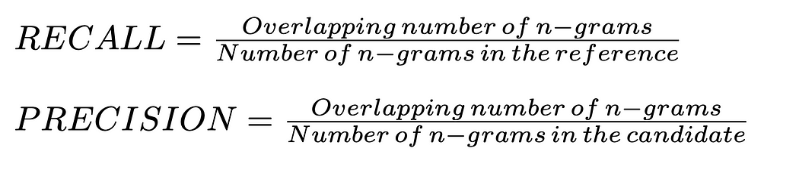
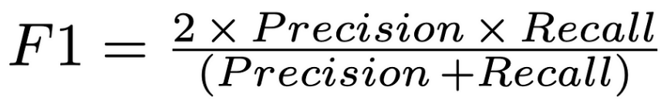
Recall-Oriented Understudy for Gisting Evaluation- ROUGE score, is a metric used to evaluate text summarization and translation models.
ROUGE-N: N indicates the number of N grams which can be 1 and 2. For ROUGE-1 it is the number of words. In ROUGE-2 it is the number of bigrams
for unigrams it is (I),(love),(Machine),(Learning)
for bigrams it is (I love),(love Machine),(Machine Learning)
ROUGE-1
Candidate 1 : Summarization is cool Reference 1 : Summarization is beneficial and cool Reference 2 : Summarization saves time.
Overlapping words(unigrams) for reference 1 is more than reference 2.
Recall = 3/5 = 0.6 Precision = 3/3 = 1 Rouge_1= 2*(0.6)*(1)/((0.6)+1) = 0.75
candidate 2 : I love Machine Learning best reference : I think i love Machine Learning
Recall = 4/6 = 0.66 Precision = 4/4 = 1 Rouge_1 = 2*0.66*1/(1+0.66) = 0.795 (approximately)
candidate 3 : Good night best reference : Good night everyone! Recall = 2/3 = 0.66 Precision = 2/2 = 1 Rouge_1 = 2*0.66*1/(1+0.66) = 0.795 (approximately)
ROUGE-2
It’s the same process as above but right now bigrams are determined.
candidate 1 : (Summarization is),(is cool) reference 1: (Summarization is),(is beneficial),(beneficial and),(and cool) reference 2: (Summarization saves),(saves time)
In terms of bigrams there is only one match in reference 1 and there is none at reference 2.
Recall = 1/4 = 0.25 Precision = 1/2 = 0.5 Rouge_2 = (2*0.5*0.25)/(0.5+0.25) = 0.33
candidate 2 candidate 2 : (I love),(love Machine),(Machine Learning) best reference = (I think),(think i),(i love),(love Machine),(Machine Learning) Recall = 3/5 = 0.6 Precision = 3/3 = 1 Rouge_2 = (2*1*0.6)/(1+0.6) = 0.75
candidate 3 candidate 3 : (Good night) best reference : (Good night),(night everyone!) Recall = 1/2 = 0.5 Precision = 1/1 = 1 Rouge_2 = (2*1*0.5)/(1+0.5) = 0.66

Slide 5
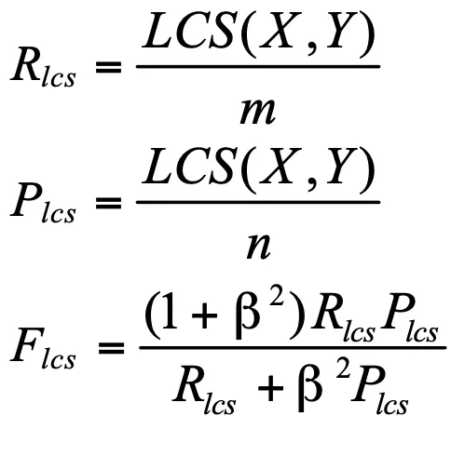
ROUGE-L Longest Common Subsequence (LCS)
LCS is the longest sequence of words that appear in both the candidates and reference summaries. It is important to note that LCSes are not necessarily consecutive but still in order. Example:
Model output: “A fast brown fox leaps over a sleeping dog.”
Reference summary: “The quick brown fox jumps over the lazy dog.”
LCS here is “brown fox over dog.”
Precision: Number of words in LCS / Number of words in the model output = 4 / 9 ≈ 0.444 Recall: Number of words in LCS / Number of words in the reference summary = 4 / 9 ≈ 0.444 F1-score = (2 * 0.444 * 0.444) / (0.444 + 0.444) ≈ 0.444
X is a reference summary sentence and Y is a candidate summary sentence with sizes m,n respectively. Beta is a parameter in the ROUGE-L score that controls the relative importance of precision and recall. When beta is 1 the ROUGE-L score is simply the harmonic mean of precision and recall.

Slide 6
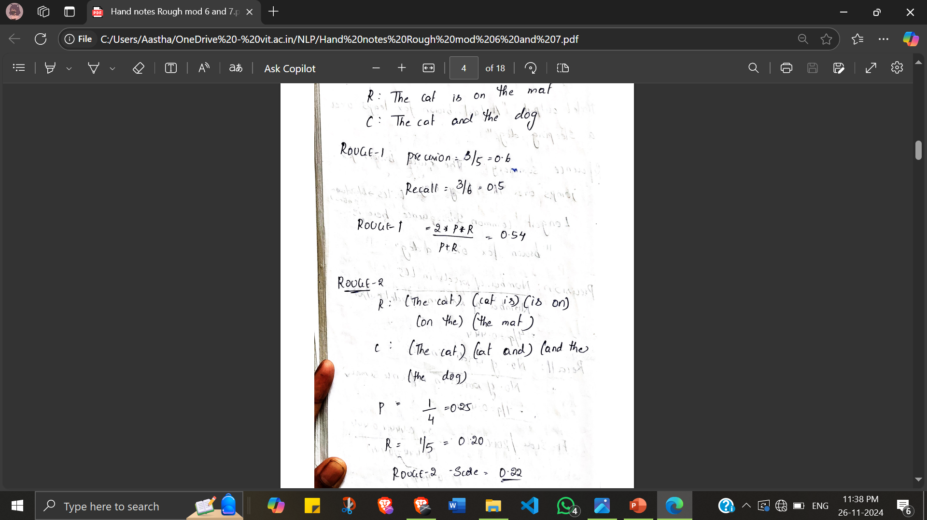
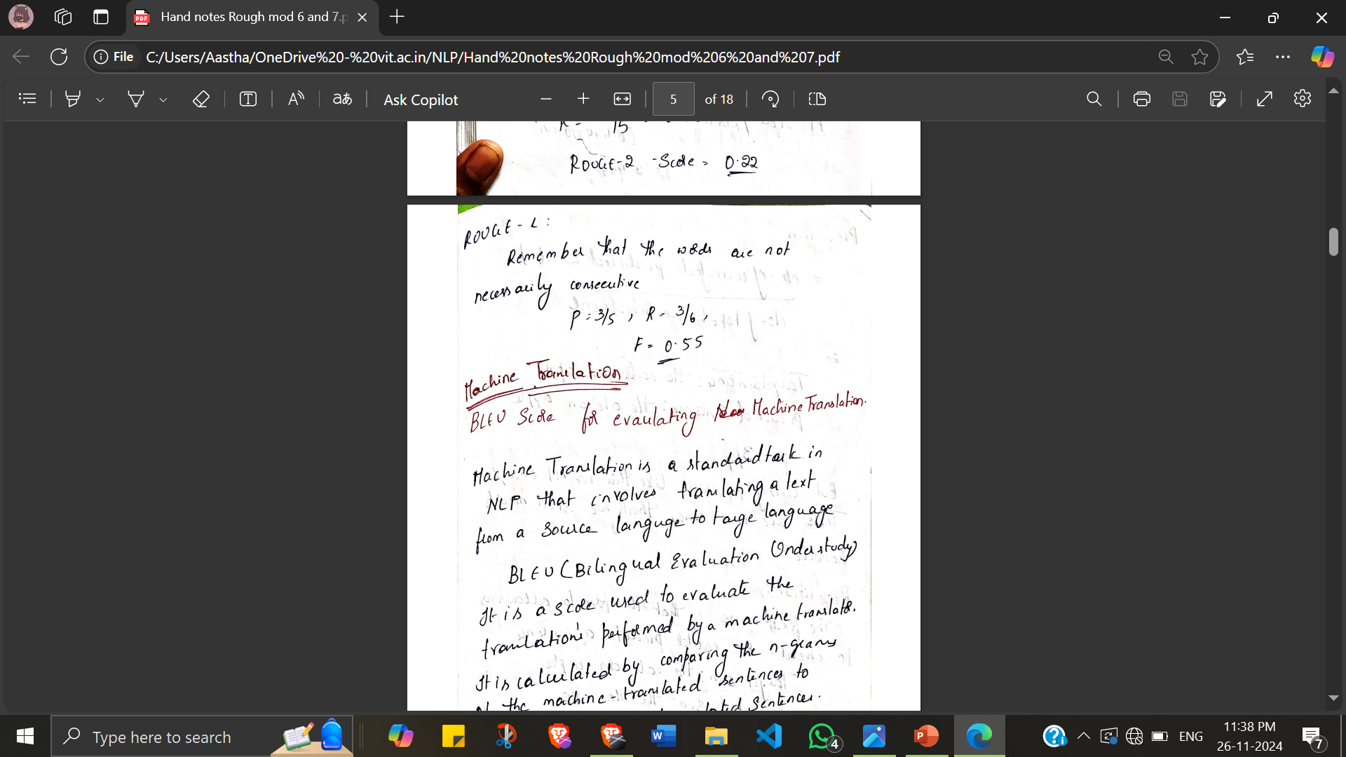
Advantages of ROUGE:
correlate well with human evaluation.
easy to calculate and understand.
language independent. So it can be used to evaluate summaries in any language.
Disadvantages of ROUGE:
ROUGE only measures n-gram overlap. So it does not take into account the semantic meaning of the summary.
It is sensitive to the choice of reference summaries.
It can be biased towards summaries that are shorter or longer than the reference summaries

Slide 7
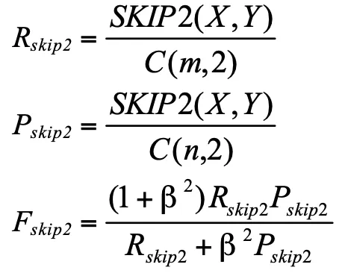
ROUGE-S
ROUGE-S stands for skip-grams. The order of the words in each sequence is preserved, but arbitrary gaps are allowed between words. For example - Sentence: police killed the gunman
(“police killed”, “police the”, “police gunman”, “killed the”, “killed gunman”, “the gunman”)
ROGUE vs BLEU:
BLEU focuses on precision
ROGUE focuses on recall

Slide 8
Speech Acts (aka Dialogue Acts)
Two kind of conversational agents
Chatbots: mimic informal human chatting; for fun or therapy
Task-based Dialogue Agents: interfaces to personal assistants; cars, robots, appliances, booking flights or restaurants
Constatives: committing the speaker to something’s being the case (answering, claiming, confirming, denying, disagreeing, stating)
Directives: attempts by the speaker to get the addressee to do something (advising, asking, forbidding, inviting, ordering, requesting)
Commissives: committing the speaker to some future course of action (promising, planning, vowing, betting, opposing)
Acknowledgments: express the speaker’s attitude regarding the hearer with respect to some social action (apologizing, greeting, thanking, accepting an acknowledgment)

Slide 9


Grounding
Principle of closure. Agents performing an action require evidence, sufficient for current purposes, that they have succeeded in performing it
Grounding: acknowledging that the hearer has understood. Eg ; elevator buttons light up when you press them
System: Did you want to review some more of your profile? User: No.
System: What’s next?
System: Did you want to review some more of your profile? User: No.
System: Okay, what’s next?

Slide 10
Chatbot Architectures
A reporter interviewing a chef asks questions, and the chef responds. This reporter has the conversational initiative (Some conversations are controlled by one person)
User initiative (user asks or commands, system responds)
System initiative (system asks user questions to fill out a form, user can't change the direction)
Most human conversations have mixed initiative: I lead, then you lead, then I lead. Mixed Inititative is difficult for NLP.
Rule-based - Pattern-action rules (ELIZA)
Corpus-based -
Response by retrieval: Use information retrieval to grab a response (that is appropriate to the context) from some corpus often using TF-IDF frequency count approach.(XiaoIce)
Response by generation: Use a language model or encoder-decoder to generate the response given the dialogue context. (BlenderBot)

Slide 11
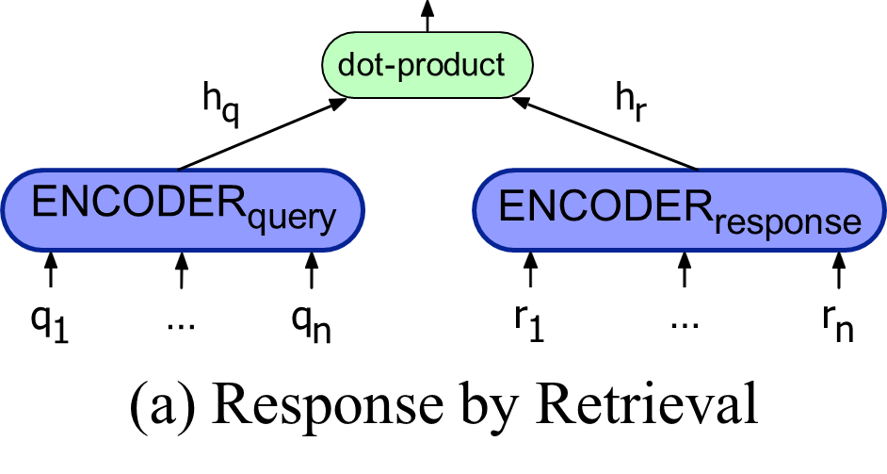
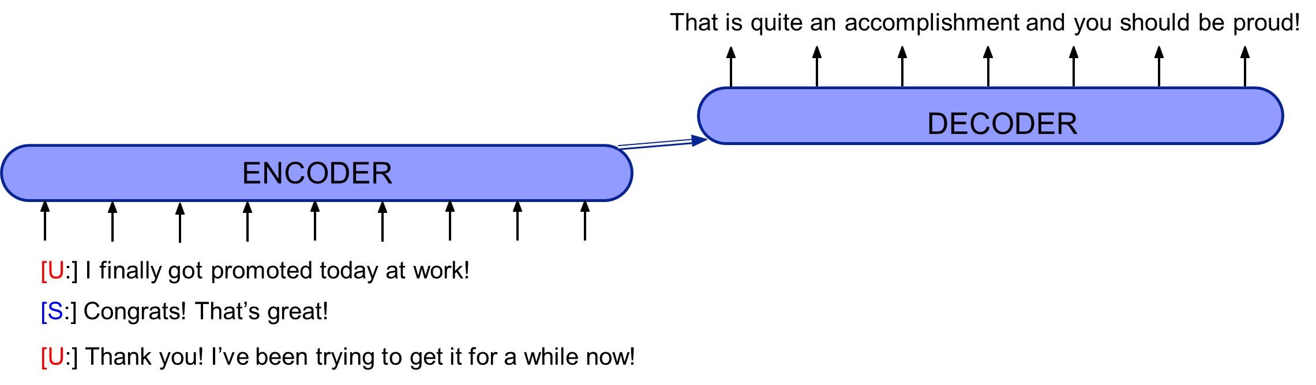
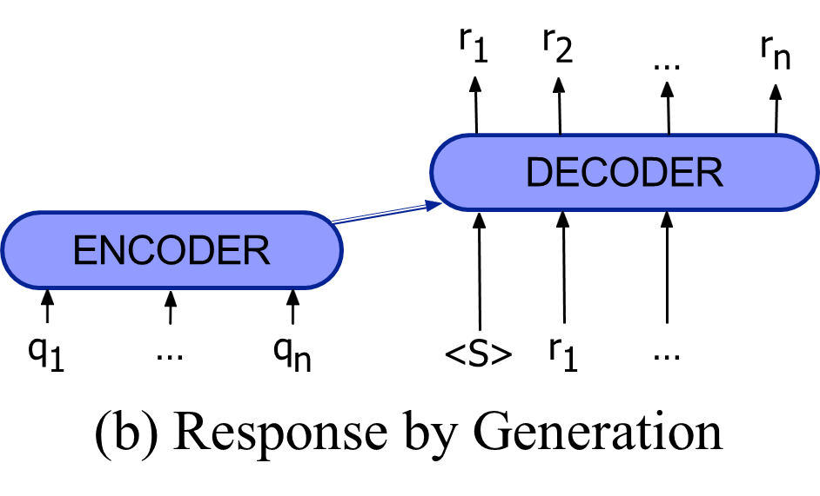

Eliza Rules - It mimics human-like conversation using simple pattern-matching and substitution rules, without actually understanding the content of the conversation. Rules are organized by keywords. Each keyword has a pattern and a list of possible transform.
Pattern: "I feel *" Response Template: "Why do you feel *?"
Pattern: "You * me" Response Template: "What makes you think I * you?"
Pattern: "Can you *" Response Template: "What makes you think I can't *?"
Pattern: (No matching keywords) Response Template: "Tell me more about that."

Slide 12
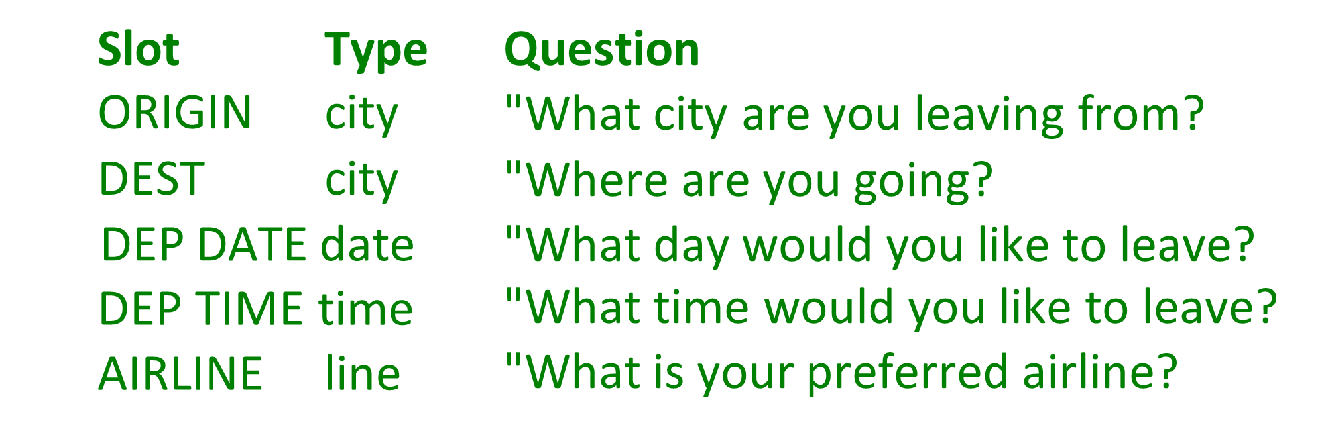
Frame-based / task-based dialogue agents
Systems that have the goal of helping a user solve a task like making a travel reservation or buying a product
One or more frames (each consisting of slots with values)
Eg: GUS architecture - System asks questions of user, filling any slots that user specifies

Slide 13
GUS slots have condition-action rules attached for eg:-
Once the user has specified the destination, enter that city as the default StayLocation for the hotel booking frame.
Once the user has specified DESTINATION DAY for a short trip, Automatically copy as ARRIVAL DAY.
GUS systems have multiple frames for eg: -
Car or hotel reservations
General route information
Information about airfare practices
Frame detection:
System must detect which slot of which frame user is filling.
Done by domain classification and intent determinaition

Slide 14
Dialogue-State or Belief-State Architecture
A more sophisticated version of the frame-based architecture
NLU: extracts slot fillers from the user’s utterance using ML
Dialogue state tracker: maintains the current state of the dialogue (user’s most recent dialogue act, set of slot-filler constraints from user
Dialogue policy: decides what the system should do or say next
GUS policy: ask questions until the frame was full then report back
More sophisticated: know when to answer questions, when to ask a clarification question, etc.
NLG: produce more natural, less templated utterances

Slide 15
Dialogue Acts
Combine the ideas of speech acts and grounding into a single
representation
Young et al., 2010:
Tag | Sys User |  | Description
HELLO(a = x, b = y, ...) | X | X | Open a dialogue and give info a = x, b = y, ...
INFORM(a = x, b = y, ...) | X | X | Give info a = x, b = y, ...
REQUEST(a, b = x, ...) | X | X | Request value for a given b = x, ...
REQALTS(a = x, ...) | c | X | Request alternative with a = x, ...
CONFIRM(a = x, b = y, ...) | X | X | Explicitly confirm a = x, b = y, ...
CONFREQ(a = x,..., d) | X | c | Implicitly confirm a = x, ... and request value of d
SELECT(a = x, a = y) | X | c | Implicitly confirm a = x, ... and request value of d
AFFIRM(a = x, b = y, ...) | X | X | Affirm and give further info a = x, b = y, ...
NEGATE(a = x) | c | X | Negate and give corrected value a = x
DENY(a = x) | c | X | Deny that a = x
BYE() | X | X | Close a dialogue

Slide 16
Dialogue Acts
Young et al., 2010:
Utterance Dialogue act U: Hi, I am looking for somewhere to eat. hello(task = find,type=restaurant) S: You are looking for a restaurant. What confreq(type = restaurant, food) type of food do you like? U: I’d like an Italian somewhere near the inform(food = Italian, near=museum) museum. S: Roma is a nice Italian restaurant near inform(name = "Roma", type = restaurant, the museum. food = Italian, near = museum) U: Is it reasonably priced? confirm(pricerange = moderate) S: Yes, Roma is in the moderate price affirm(name = "Roma", pricerange = range. moderate)
U: | What is the phone number? | request(phone)
S: | The number of Roma is 385456. | inform(name = | "Roma", | phone | = | "385456")
U: | Ok, thank you goodbye. | bye()

Slide 17
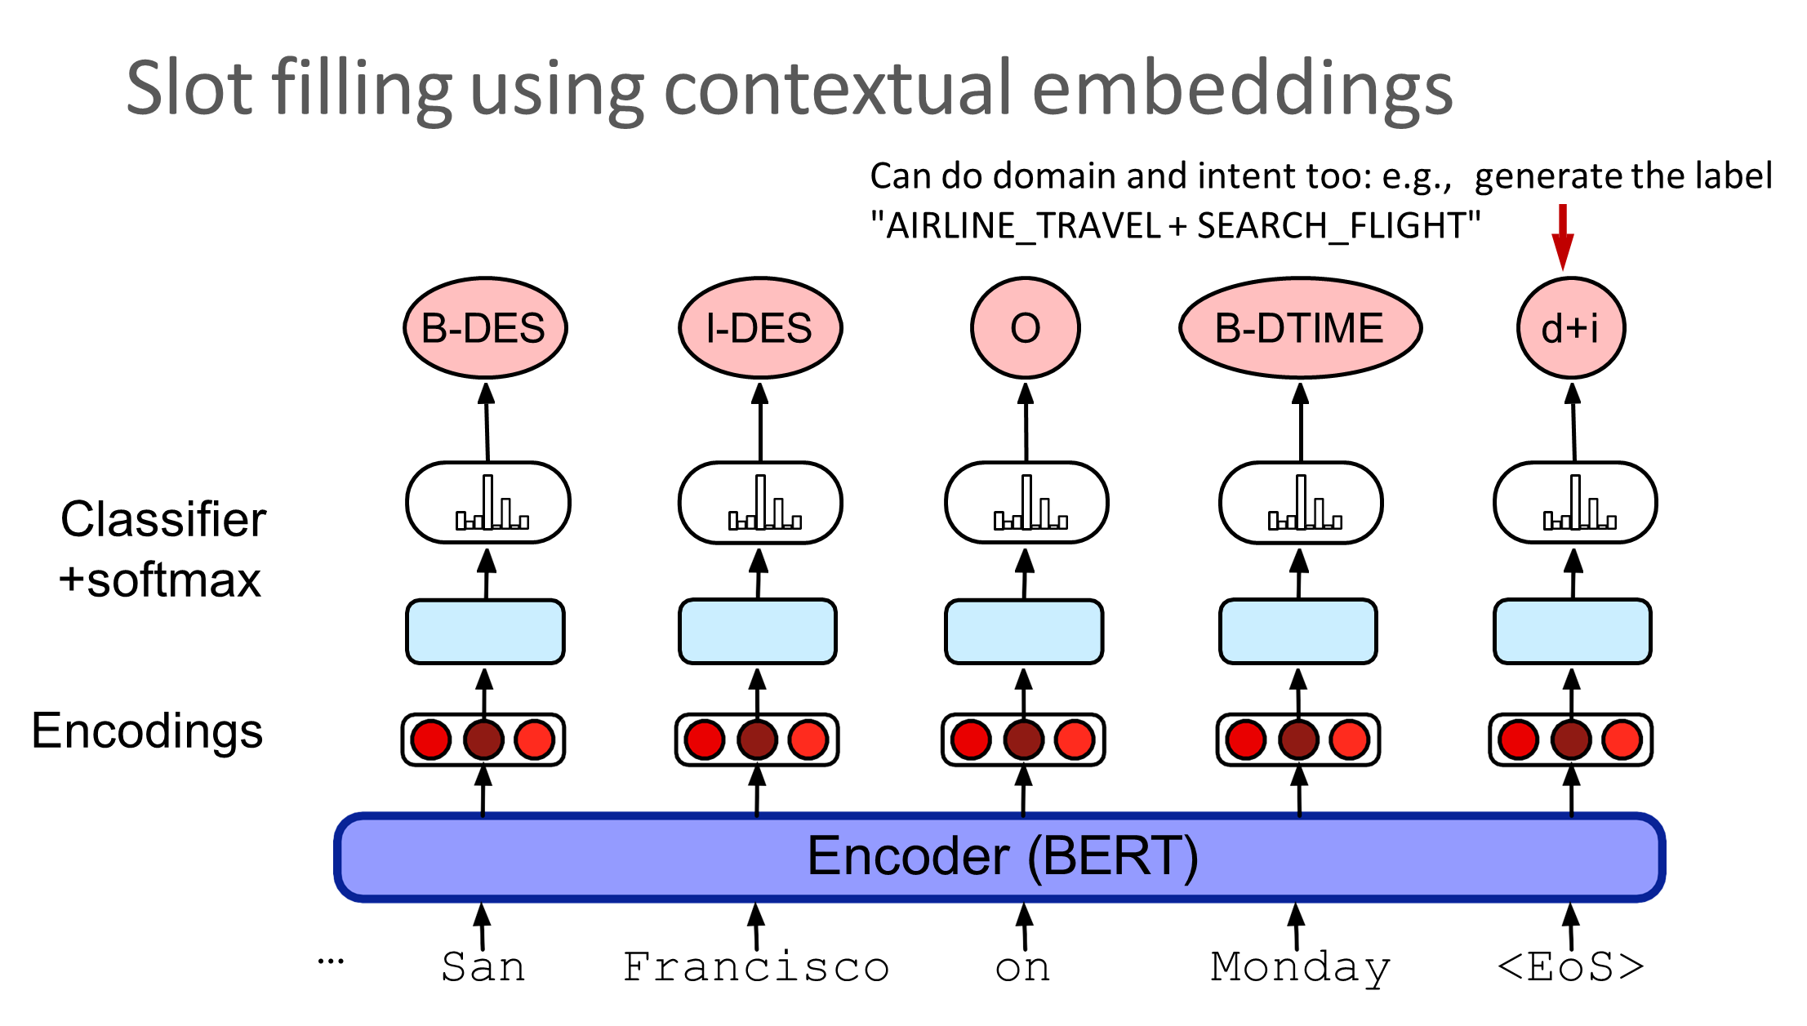
Slot filling as sequence labeling: BIO tagging
Idea: Train a classifier to label each input word with a tag that tells us what slot (if any) it fills and convert the training data to this format
O | O | O | O | O | B-DES | I-DES | O | B-DEPTIME | I-DEPTIME | O
I | want | to | fly | to | San | Francisco | on | Monday | afternoon | please

Slide 18
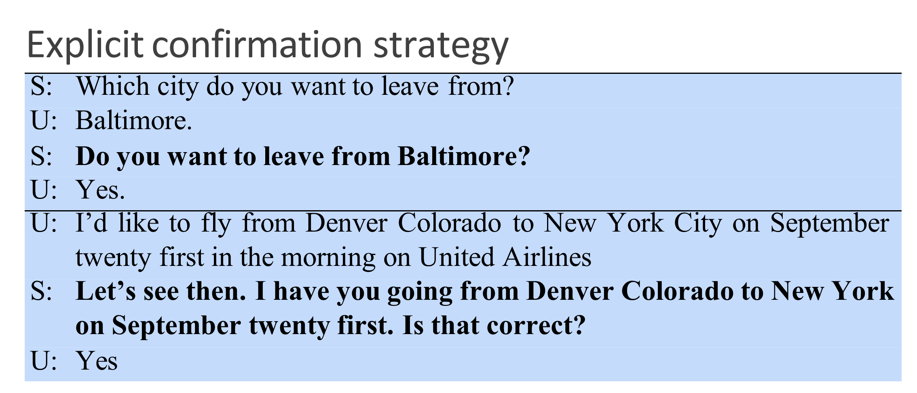
Features for detecting corrections in spoken dialogue
features | examples
lexical | words like “no”, “correction”, “I don’t”, swear words, utterance length
semantic | similarity (word overlap or embedding dot product) between the candidate correction act and the user’s prior utterance
phonetic | phonetic overlap between the candidate correction act and the user’s prior ut- terance (i.e. “WhatsApp” may be incorrectly recognized as “What’s up”)
Two important mechanisms:
confirming understandings with the user
rejecting utterances that the system is likely to have misunderstood.

Slide 19
Using confidence to decide whether to confirm:
confidence value indicates how likely system understood the user.
Systems could use set confidence thresholds:
< a | low confidence | reject
≥ a | above the threshold | confirm explicitly
≥ b | high confidence | confirm implictly
≥ g | very high confidence | don’t confirm at all

Slide 20
Sentence Realization
Delexicalization: replacing words in the training set that represent slot values with a generic placeholder token:
recommend(restaurant name= Au Midi, neighborhood = midtown, cuisine = french
Au Midi is in Midtown and serves French food.
There is a French restaurant in Midtown called Au Midi.
recommend(restaurant name= Au Midi, neighborhood = midtown,
cuisine = french
restaurant name is in neighborhood and serves cuisine food.
There is a cuisine restaurant in neighborhood called restaurant name.

Slide 21
Sentence Realization: mapping from frames to delexicalized sentences
[name] has decent
service
Encoder-decoder models:
DECODER
ENCODER
RECOMMEND service: decent cuisine: null
Output:
restaurant_name has decent service
Relexicalize to:
Au Midi has decent service

Slide 22
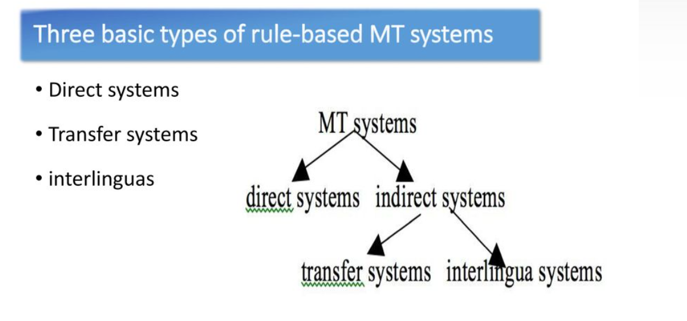
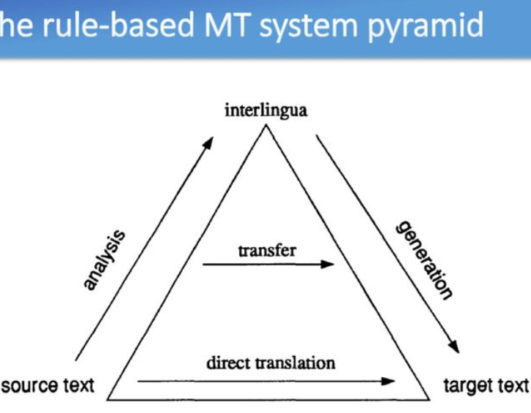
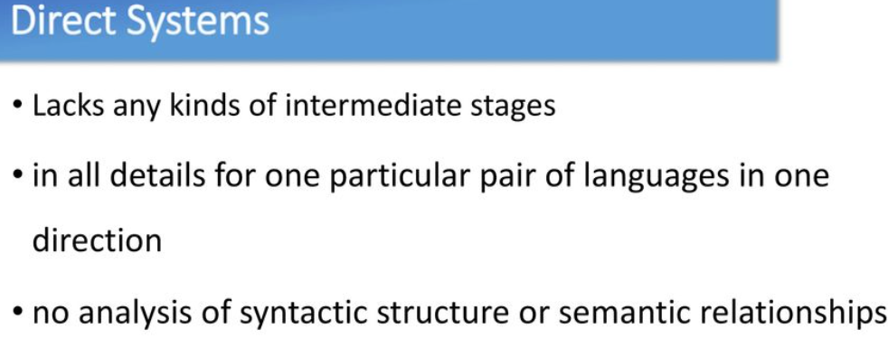
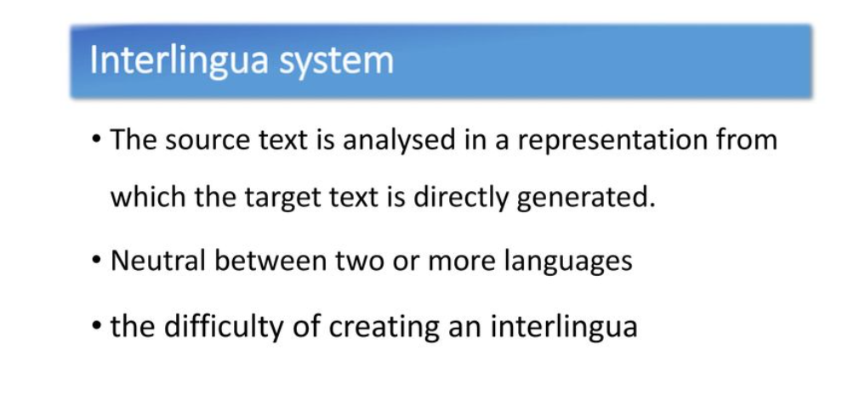

Slide 23
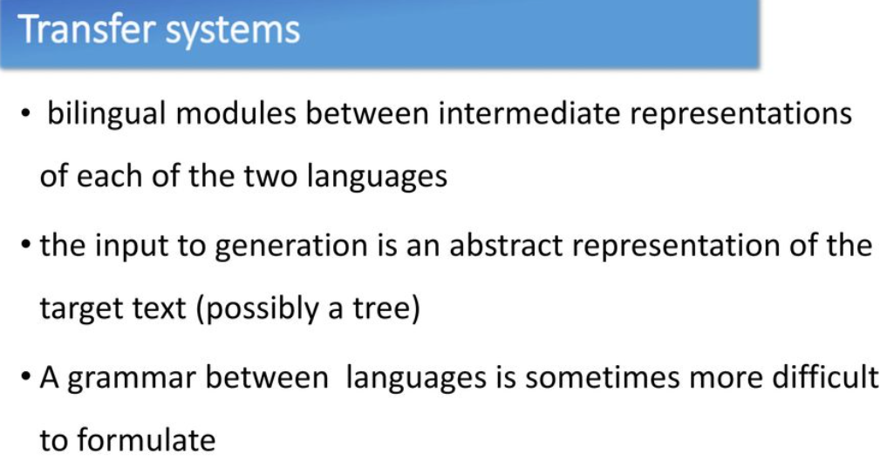
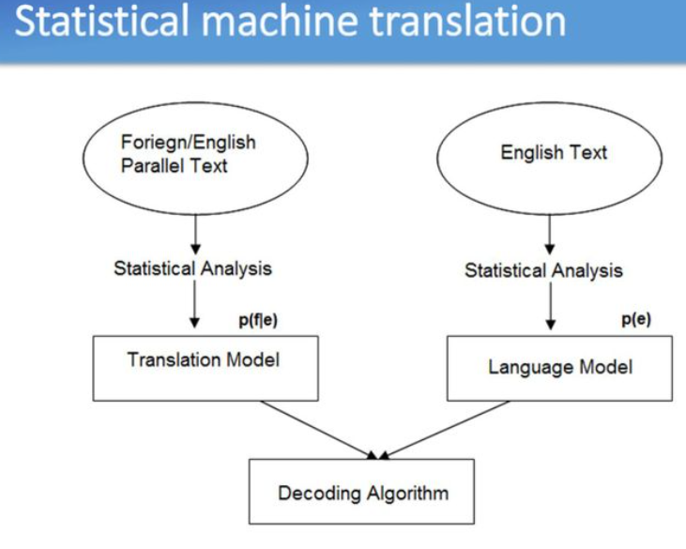
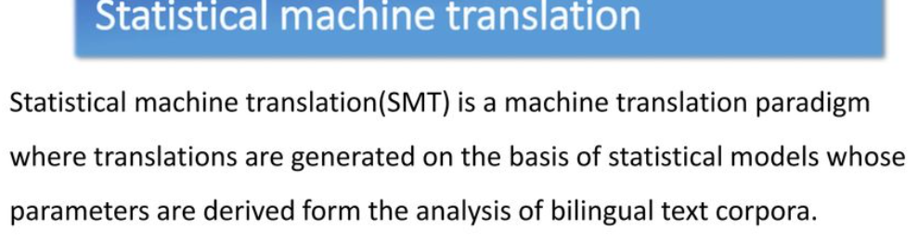
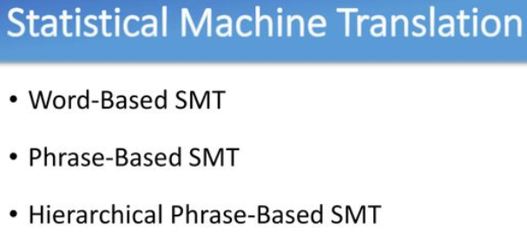

Slide 24
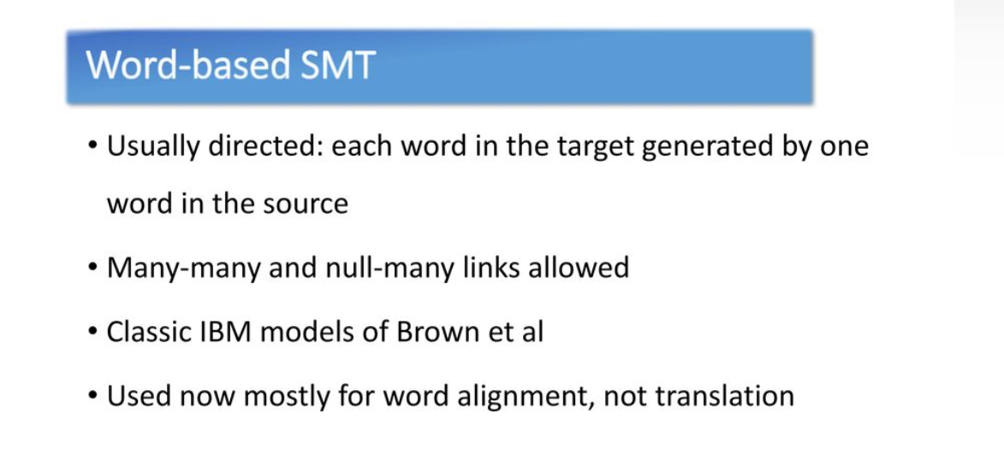
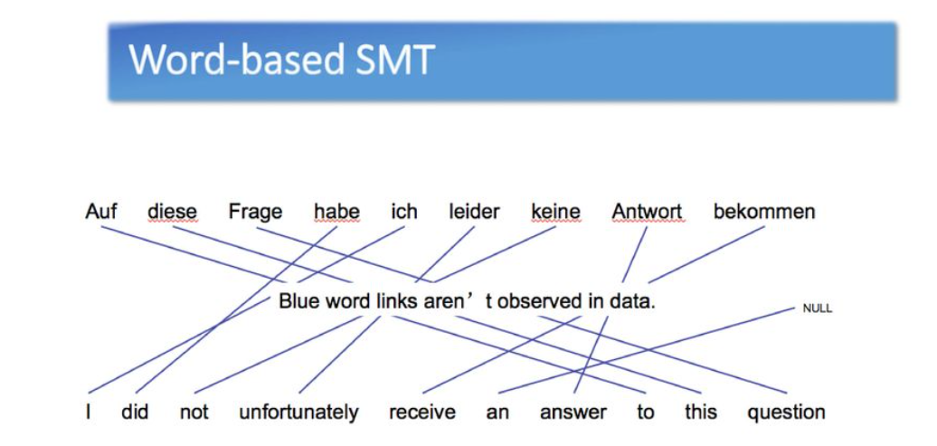
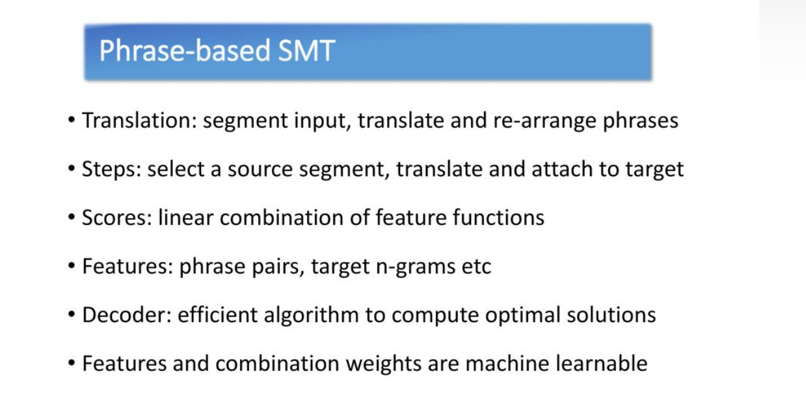
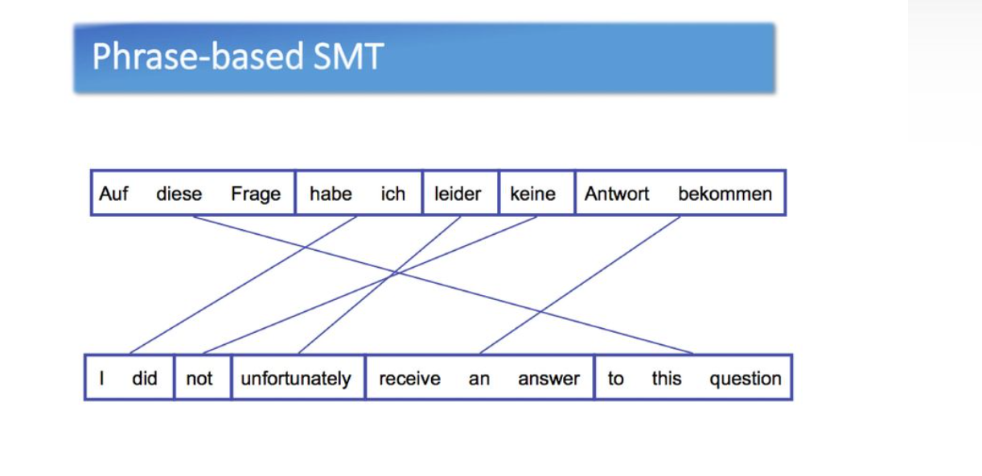
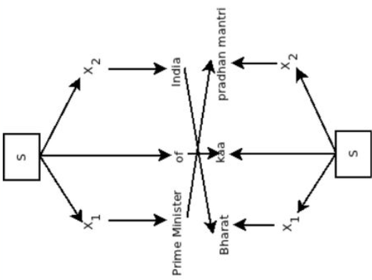
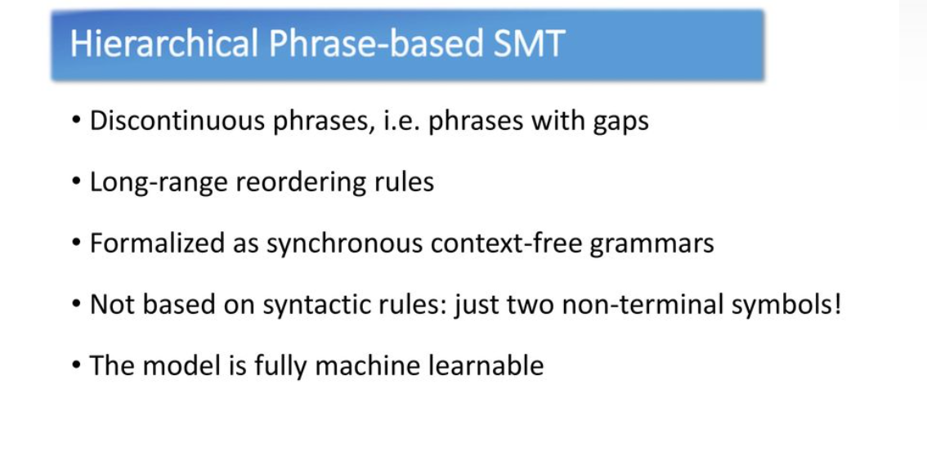

Slide 25
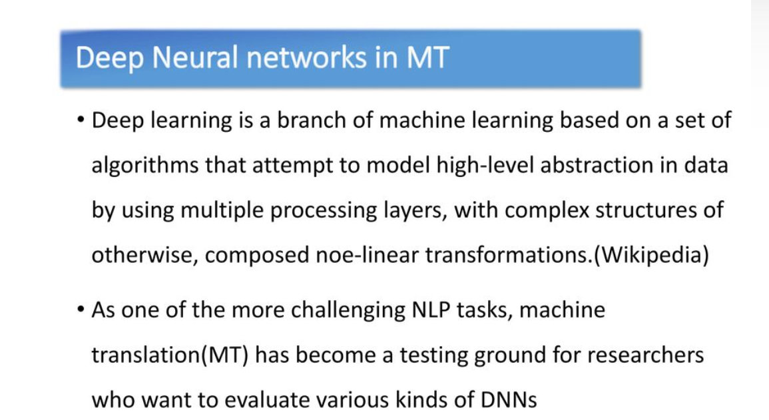
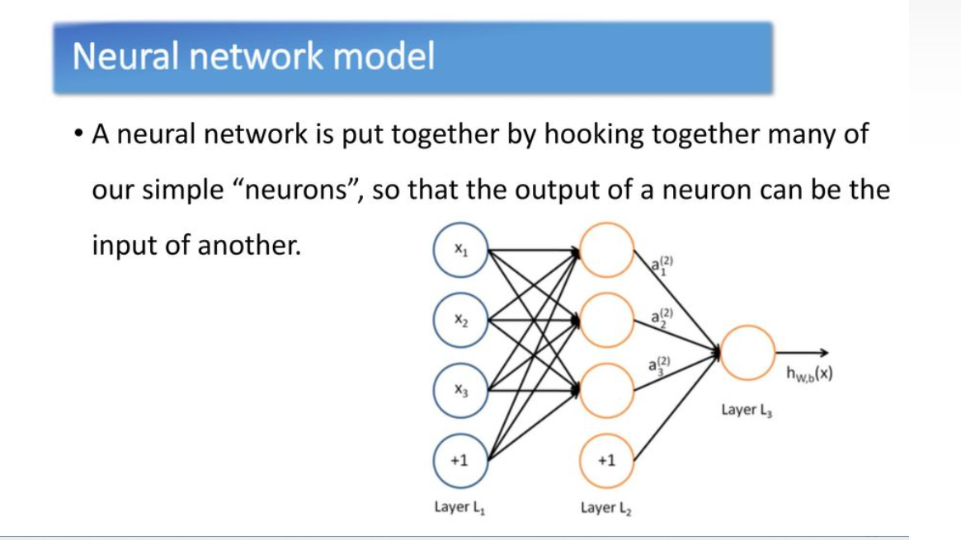
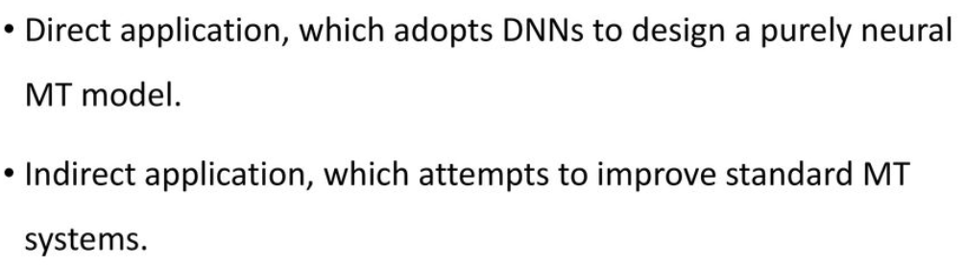
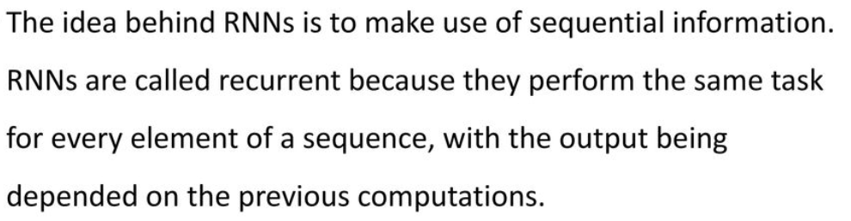
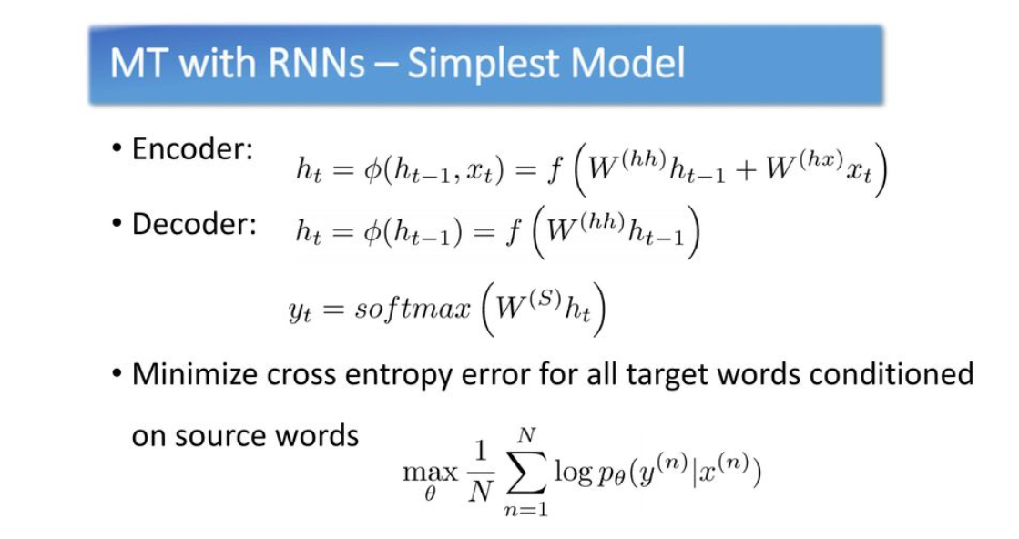
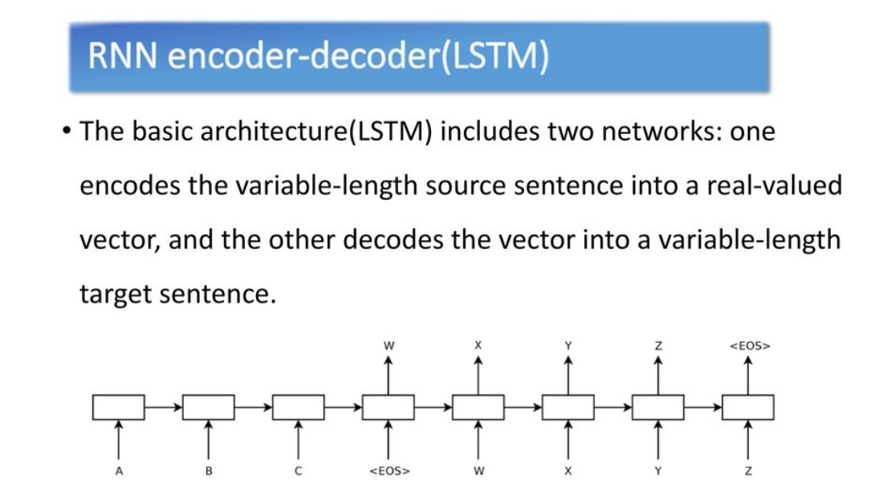

Slide 26
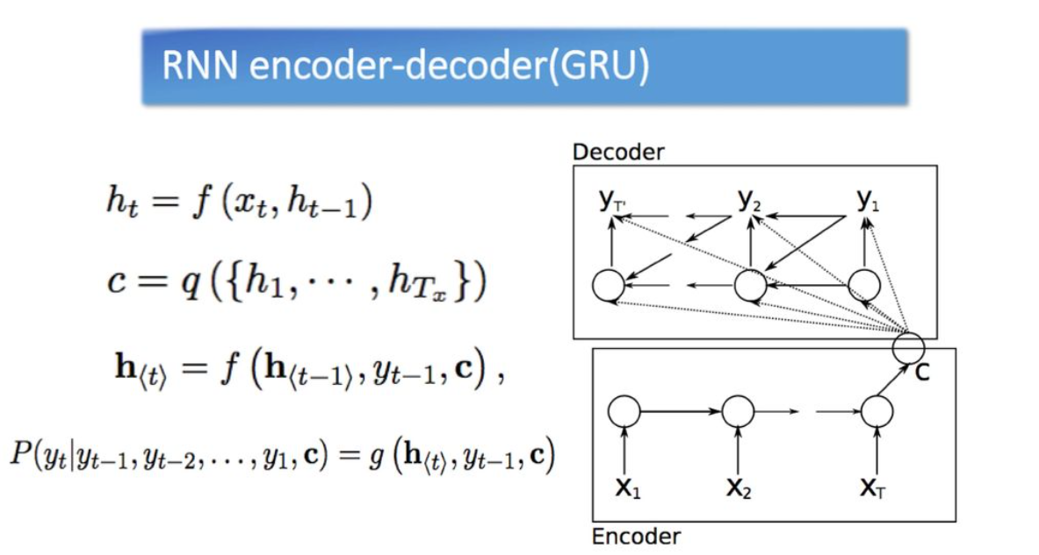
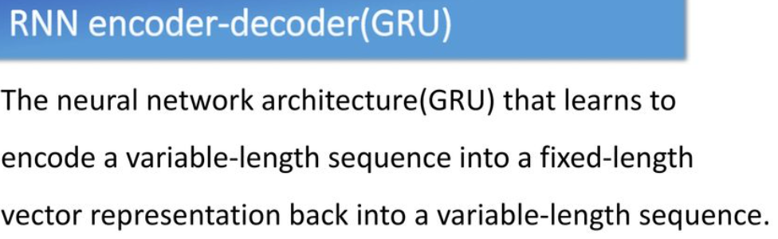
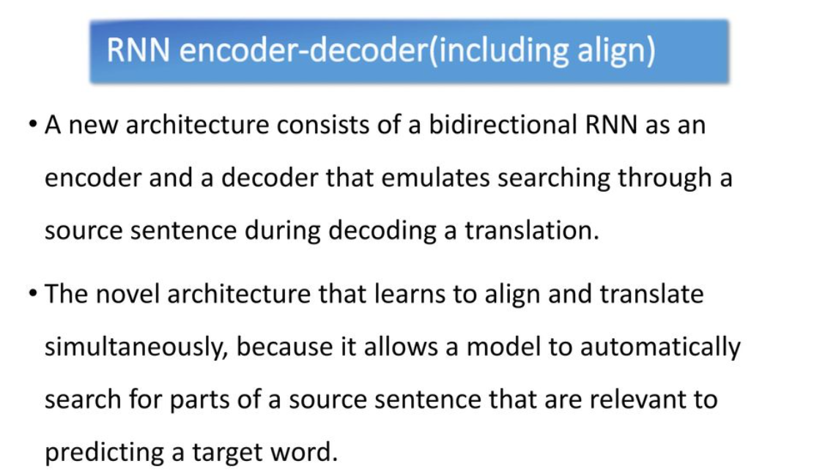
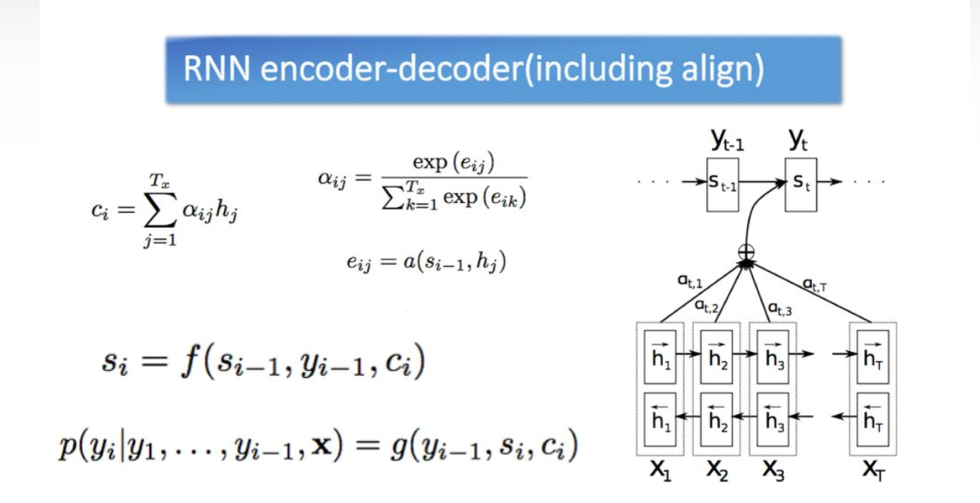

Slide 27
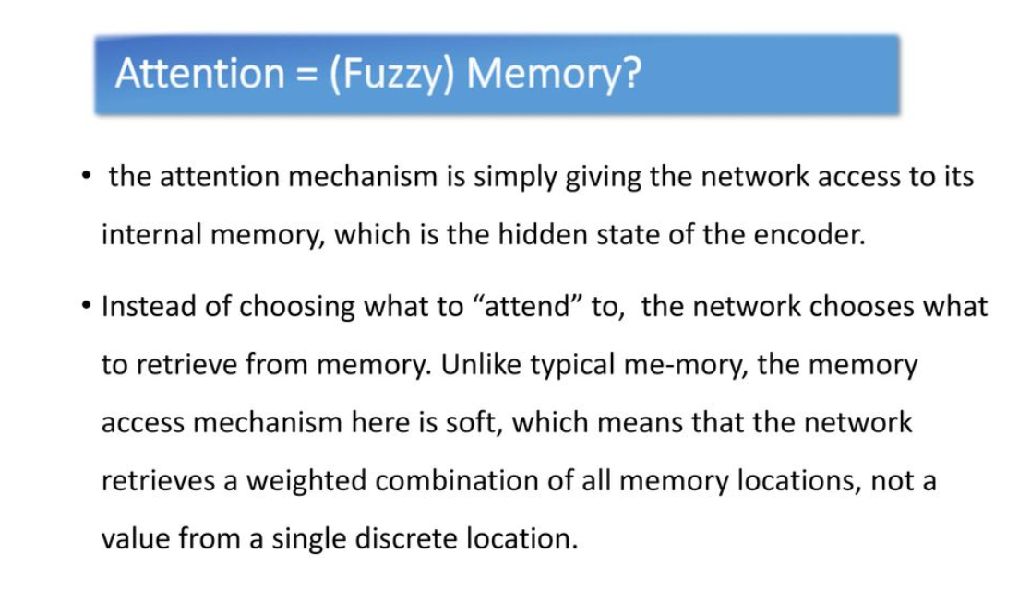

Slide 28
